Slide 1
CSC 2224: Parallel Computer
Architecture and Programming
DNN Training and Inference:
Challenges, Trends, State-of-the-Art
Prof. Gennady Pekhimenko
University of Toronto
Fall 2021

Slide 2
Review #7
Horizontally Fused Training Array
Shang Wang et al., MLSys 2021
OR
In-Datacenter Performance Analysis of a Tensor Processing Unit, ISCA’17, Jouppi et al., https://dl.acm.org/doi/10.1145/3079856.3080246
Due Nov. 2nd

Slide 3


DNN Training and Inference :
Challenges, Trends, State-of-the-Art
Gennady Pekhimenko, Assistant Professor
EcoSystem Group

Slide 4
TPU Paper to Review
In-Datacenter Performance Analysis of a Tensor Processing Unit, ISCA’17, Jouppi et al.,
https://dl.acm.org/doi/10.1145/3079856.3080246

Slide 5




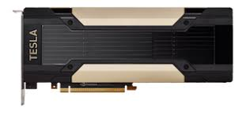
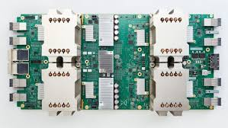



Systems/Architecture Is a Servant for ML
GPU
TPU
ML Researcher

Slide 6
Performance bottlenecks in DNN Training
Diverse benchmark suite with state-of-the-art models
Analysis & Optimizations
Tools
Key performance metrics

Slide 7
DNN Training and Inference :
Challenges
1. Benchmarking

Slide 8
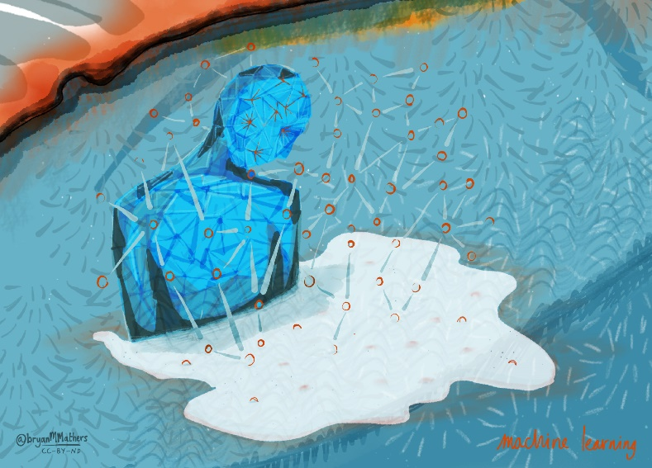


Machine Learning Benchmarking and Analysis
ISCA 2020
MLSys 2020

Slide 9
Performance bottlenecks in DNN Training
Diverse benchmark suite with state-of-the-art models
Analysis & Optimizations
Tools
Key performance metrics

Slide 10




Training Benchmarks for DNNs (TBD)
Applications | Models | Dataset | # of layers | Dominant layer | Maintainer
Image Classification | ResNet-50 _{T,M,C} Inception-v3 _{T,M,C} | ImageNet | 50 (152 max) 42 | CONV | Hongyu Zhu
Machine Translation | Seq2Seq _{T,M} Transformer _{T,M} | IWSLT15 | 5 12 | LSTM Attention | Bojian Zheng Andrew Pelegris
Object Detection | Faster RCNN _{T,M} Mask RCNN _{P} | Pascal VOC | 101 | CONV | Hongyu Zhu Zilun Zhang
Speech Recognition | Deep Speech 2 _{P, M} | LibriSpeech | 7 (9 max) | RNN | Kuei-Fang Hsueh Jiahuang Lin
Recommendation System | NCF _{P} | MovieLens | 4 | GMF, MLP | Izaak Niksan
Adversarial Network | WGAN _{T} | Downsampled ImageNet | 14+14 | CONV | Andrew Pelegris
Reinforcement Learning | A3C _{T,M} | Atari 2600 | 4 | CONV | Mohamed Akrout
(Footnotes indicate available implementation: T for , M for , C for , P for )
Notes:
This is a list of models in our benchmark set. We have 8 models that cover 6 major application domains. The footnotes here indicate that the model is available on which frameworks.
We do not implement any of them, all models we use come from open-sourced github repos. Most of them are from the official examples of the frameworks. Different frameworks are maintained by different people in this group.

Slide 11

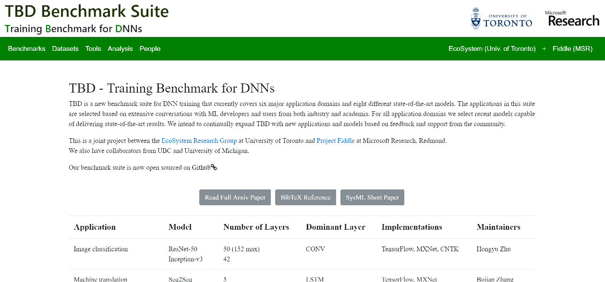
Our Focus: Benchmarking and Analysis
Building tools to analyze ML performance/efficiency
Industry/Academia de-facto standard
http://tbd-suite.ai
https://mlperf.org/

Slide 12
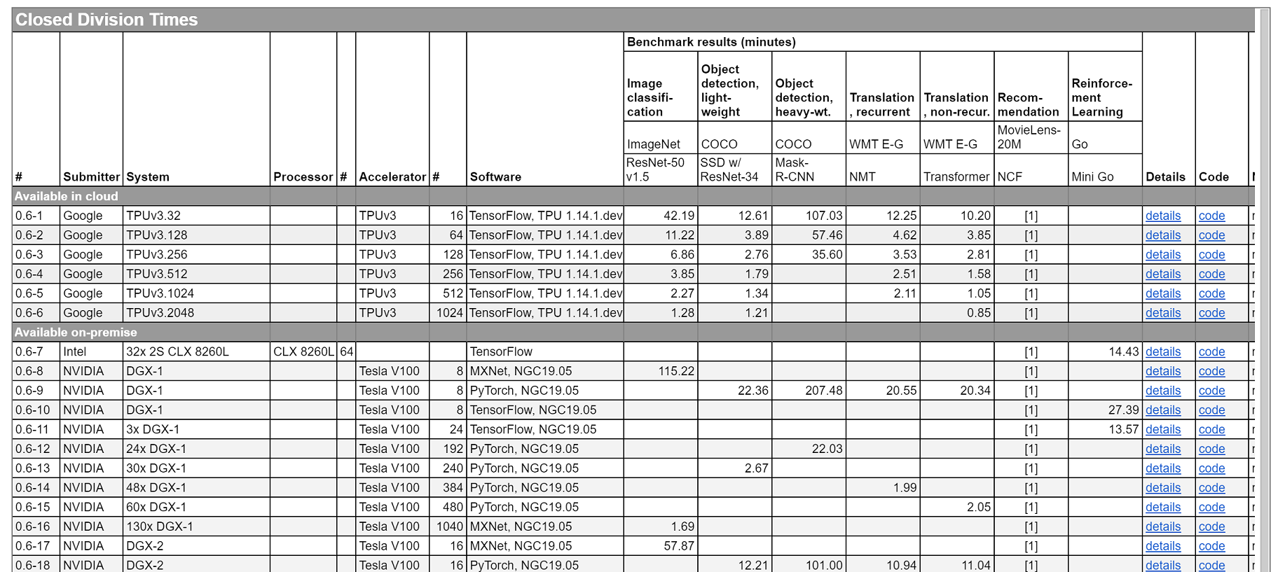
MLPerf Training Results v0.6 (July 10th, 2019)

Slide 13
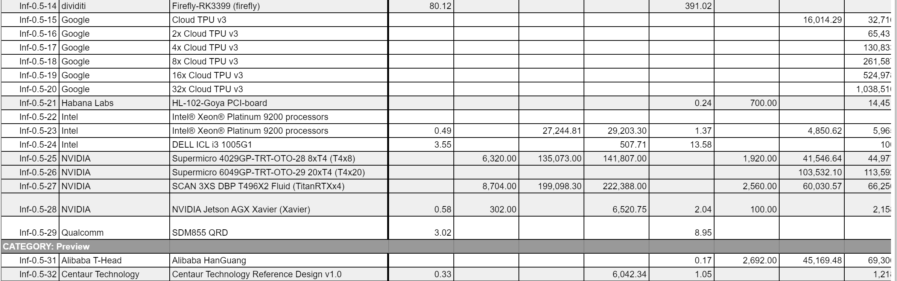
MLPerf Inference Results v0.5 (Nov. 6, 2019)

Slide 14
MLPerf becomes de-facto standard

Slide 15



MLPerf Training Benchmark
Peter Mattson, Christine Cheng, Cody Coleman, Greg Diamos, Paulius Micikevicius, David Patterson, Hanlin Tang, Gu-Yeon Wei, Peter Bailis, Victor Bittorf, David Brooks, Dehao Chen, Debojyoti Dutta, Udit Gupta, Kim Hazelwood, Andrew Hock, Xinyuan Huang, Atsushi Ike, Bill Jia, Daniel Kang, David Kanter, Naveen Kumar, Jeffery Liao, Guokai Ma, Deepak Narayanan, Tayo Oguntebi, Gennady Pekhimenko, Lillian Pentecost, Vijay Janapa Reddi, Taylor Robie, Tom St. John, Tsuguchika Tabaru, Carole-Jean Wu, Lingjie Xu, Masafumi Yamazaki, Cliff Young, and Matei Zaharia
MLSys 2020

Slide 16
MLPerf Inference accepted to ISCA 2020

Slide 17
DNN Training and Inference :
Challenges
2. Tools and Metrics

Slide 18
Performance bottlenecks in DNN Training
Diverse benchmark suite with state-of-the-art models
Analysis & Optimizations
Tools
Key performance metrics

Slide 19
Performance Metrics
Throughput
  Number of data samples processed per second
Compute Utilization
  GPU busy time over Elapsed time
FP32/FP16/Tensor Core Utilization
  Average instructions executed per cycle over Maximum instructions per cycle
Memory Breakdown
  Which data structures occupy how much memory
Notes:
Here I am going to speak about how we profile the DNN training system, and how these profiling results can motivate optimizations

Slide 20
Performance bottlenecks in DNN Training
Diverse benchmark suite with state-of-the-art models
Analysis & Optimizations
Tools
Key performance metrics

Slide 21
BERT: Memory Profile
Feature maps are still dominant in many new models

Slide 22
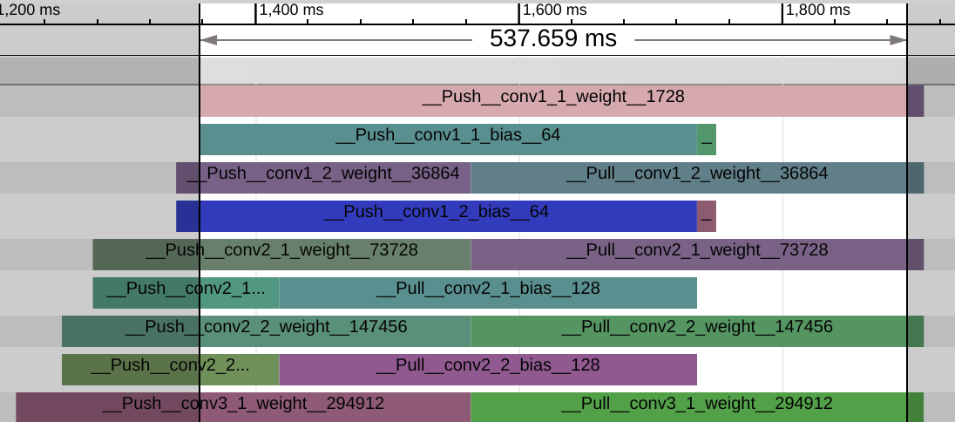
Network Profiling
Our network profiler shows the communication traces

Slide 23
Skyline Demo at MLSys 2020

Slide 24
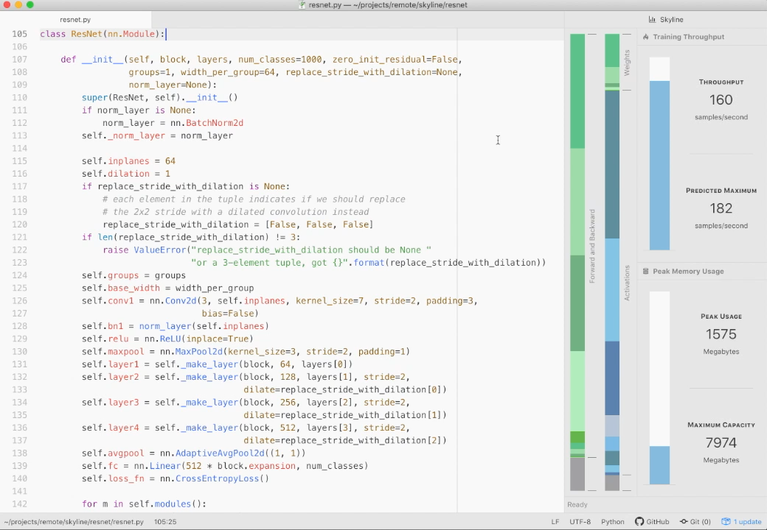


Interactive In-editor Performance Visualizations and Debugging for DNN Training
Skyline
Geoffrey X. Yu, Tovi Grossman, Gennady Pekhimenko

Slide 25
Tired of not knowing why your model is slow and/or uses up so much memory?

Slide 26
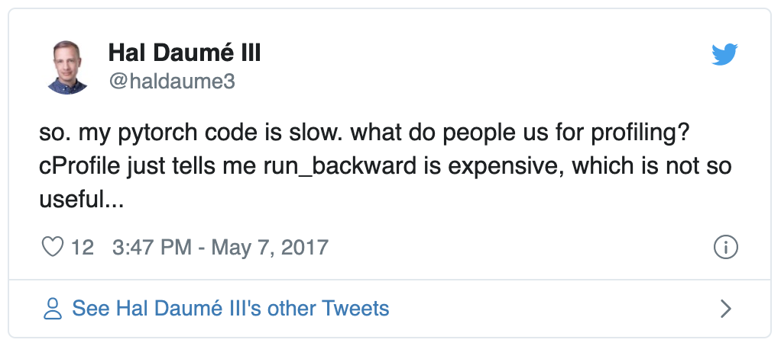
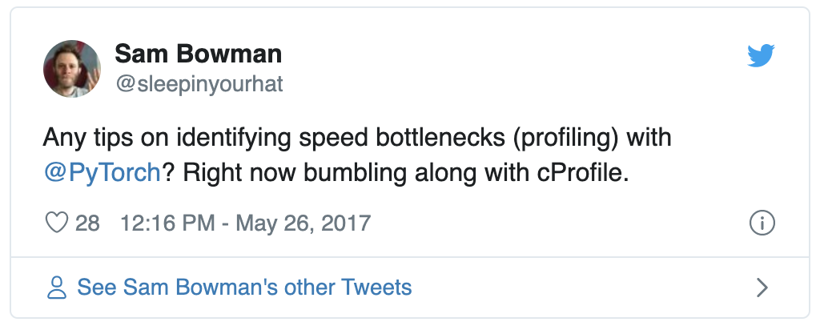
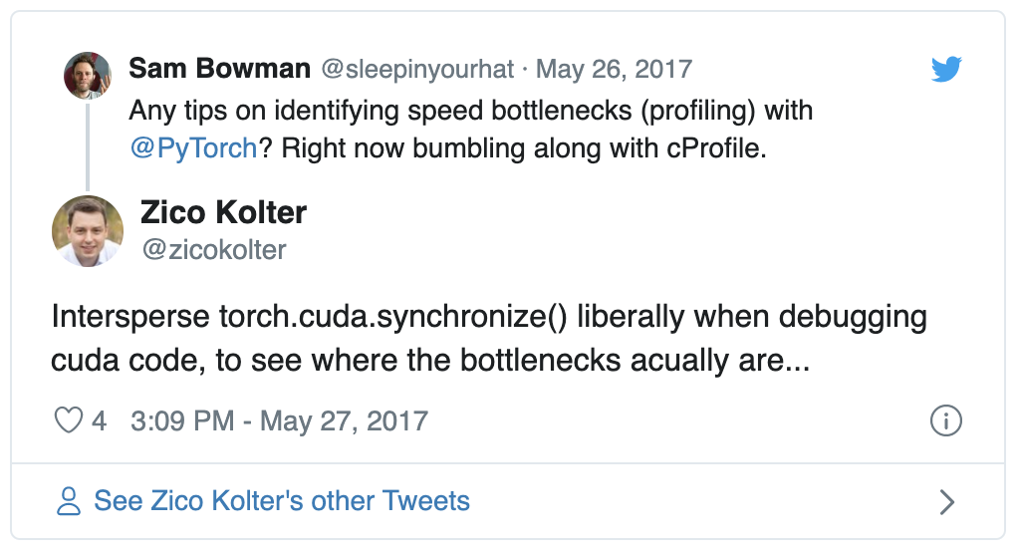
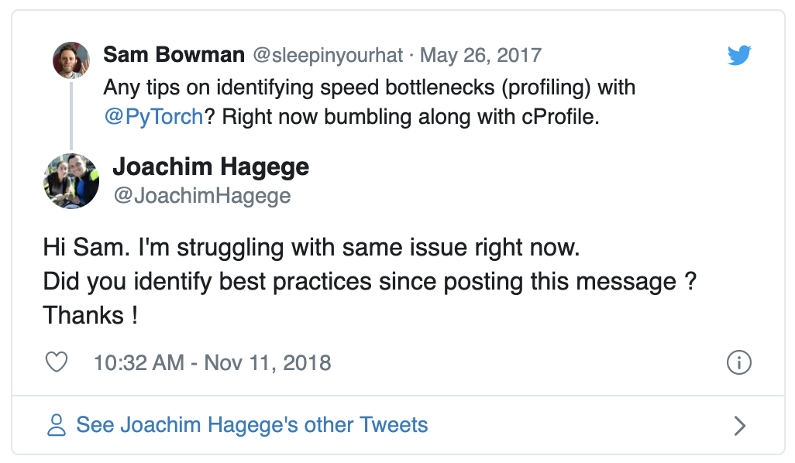
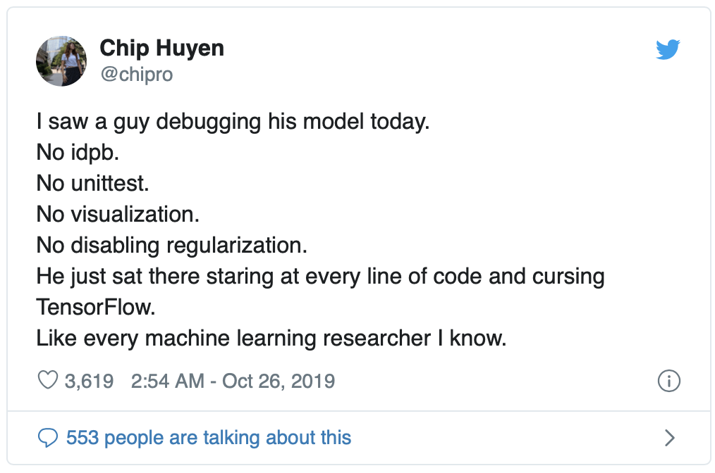
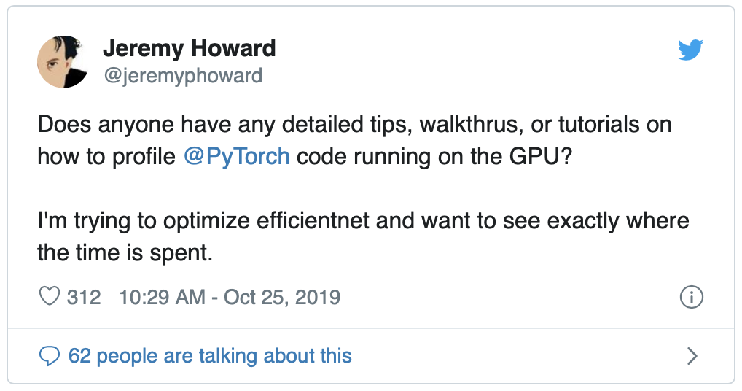
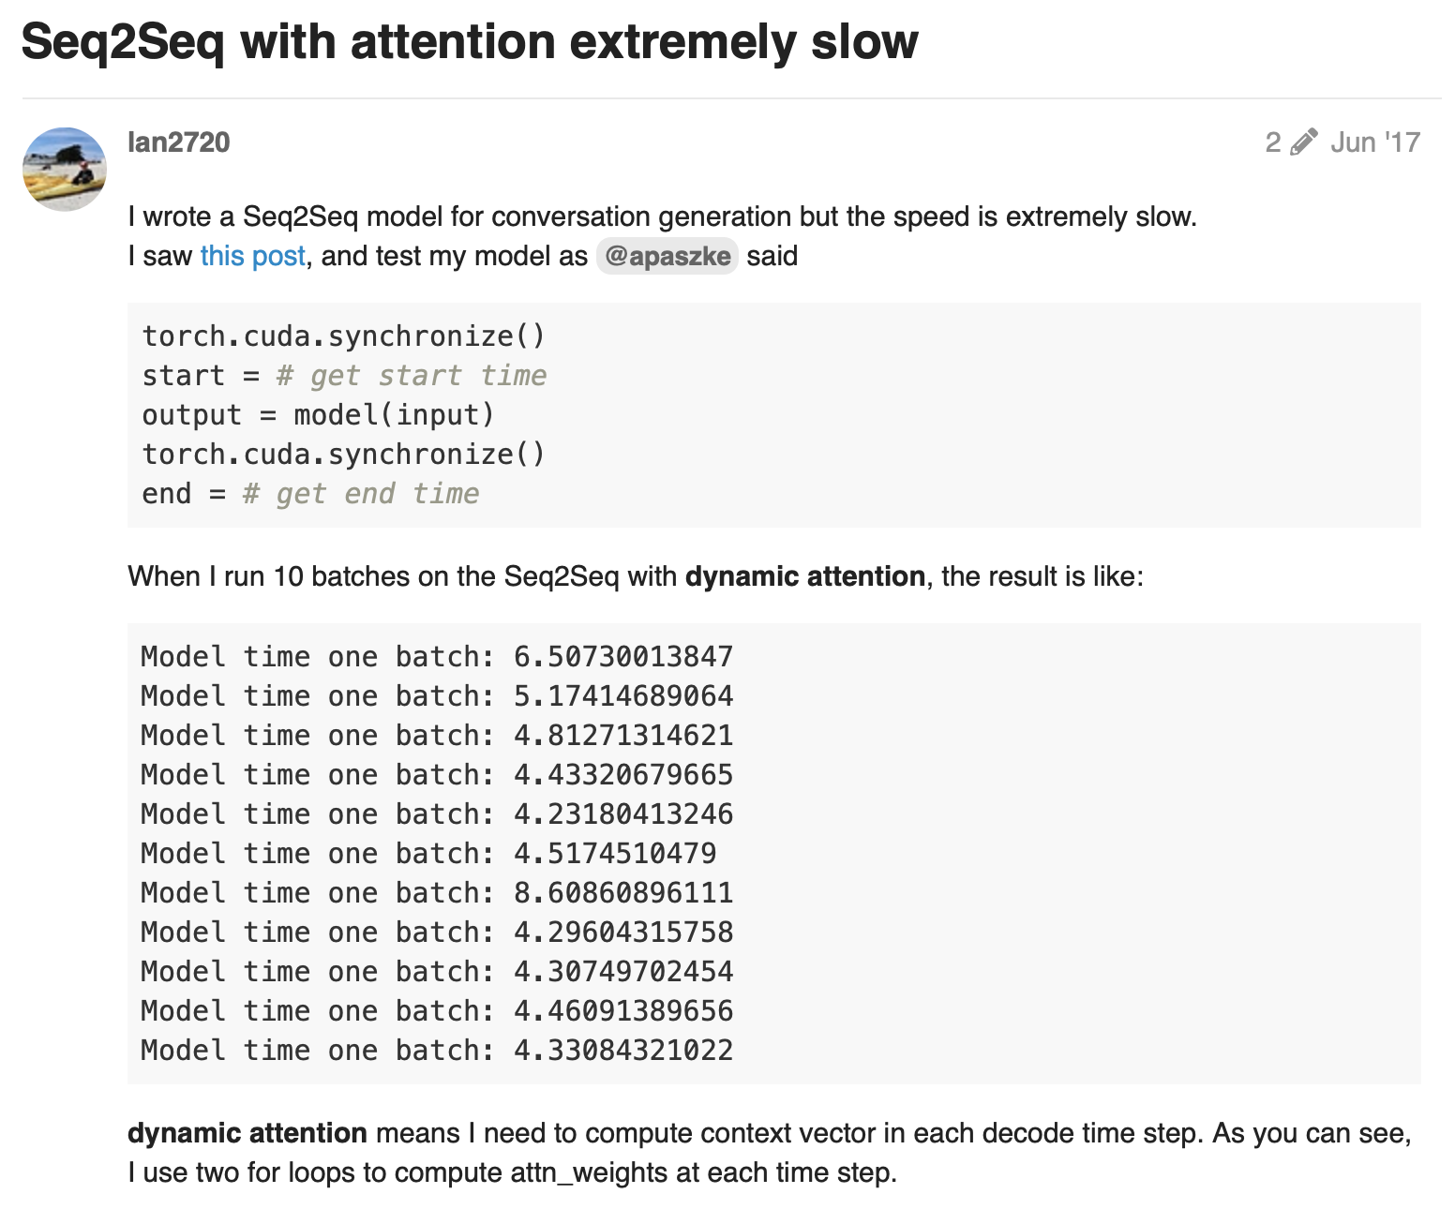
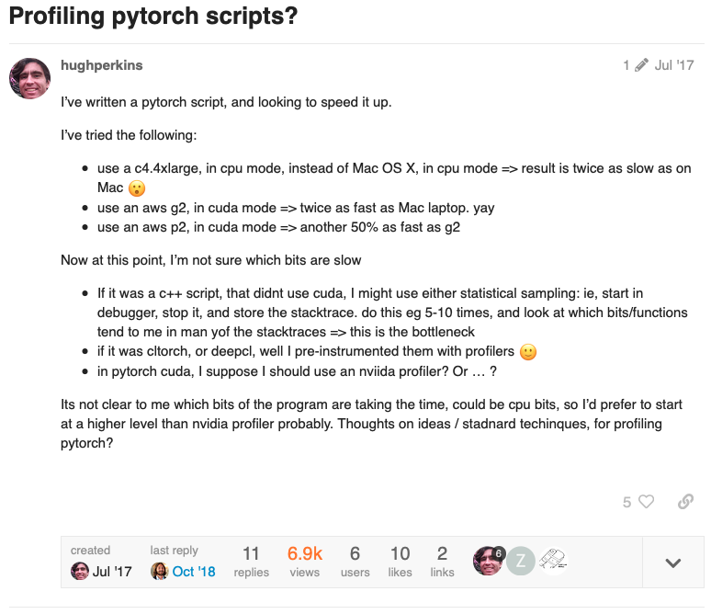
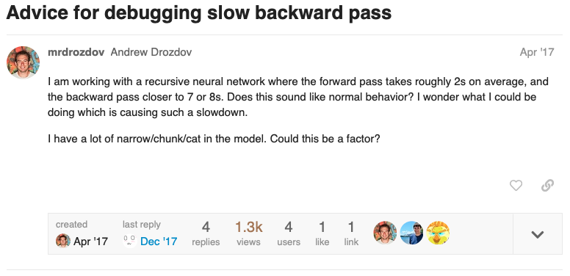
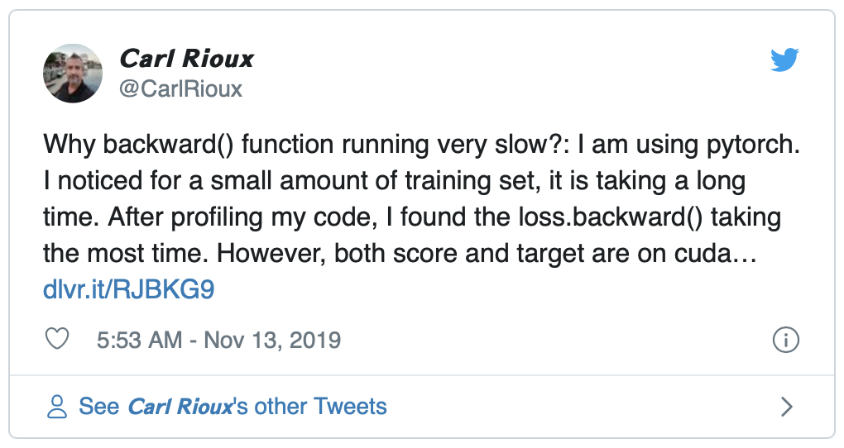
Tired of not knowing why your model is slow and/or uses up so much memory?

Slide 27


Interactive In-editor Performance Visualizations and Debugging for DNN Training
Skyline
Key performance metrics (throughput, memory usage)
Iteration run time and memory footprint breakdowns
Interactive visualizations linked to batch size predictions

Slide 28
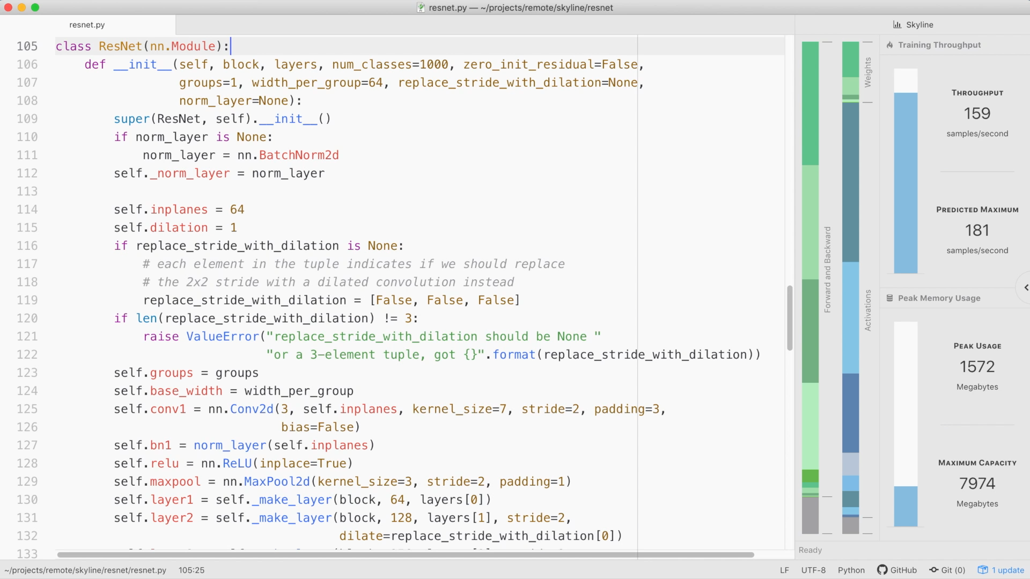
Interactive visualizations tied to the code!

Slide 29
Interactive In-editor Performance Visualizations and Debugging for DNN Training
Skyline
Learn how to use Skyline to:
Identify run time and memory bottlenecks
Tune batch sizes during development
Proactively design models with performance in mind
Skyline works with PyTorch models in Atom
$ pip install skyline-cli && \
apm install skyline

Slide 30
DNN Training and Inference :
Challenges
3. Methodology

Slide 31
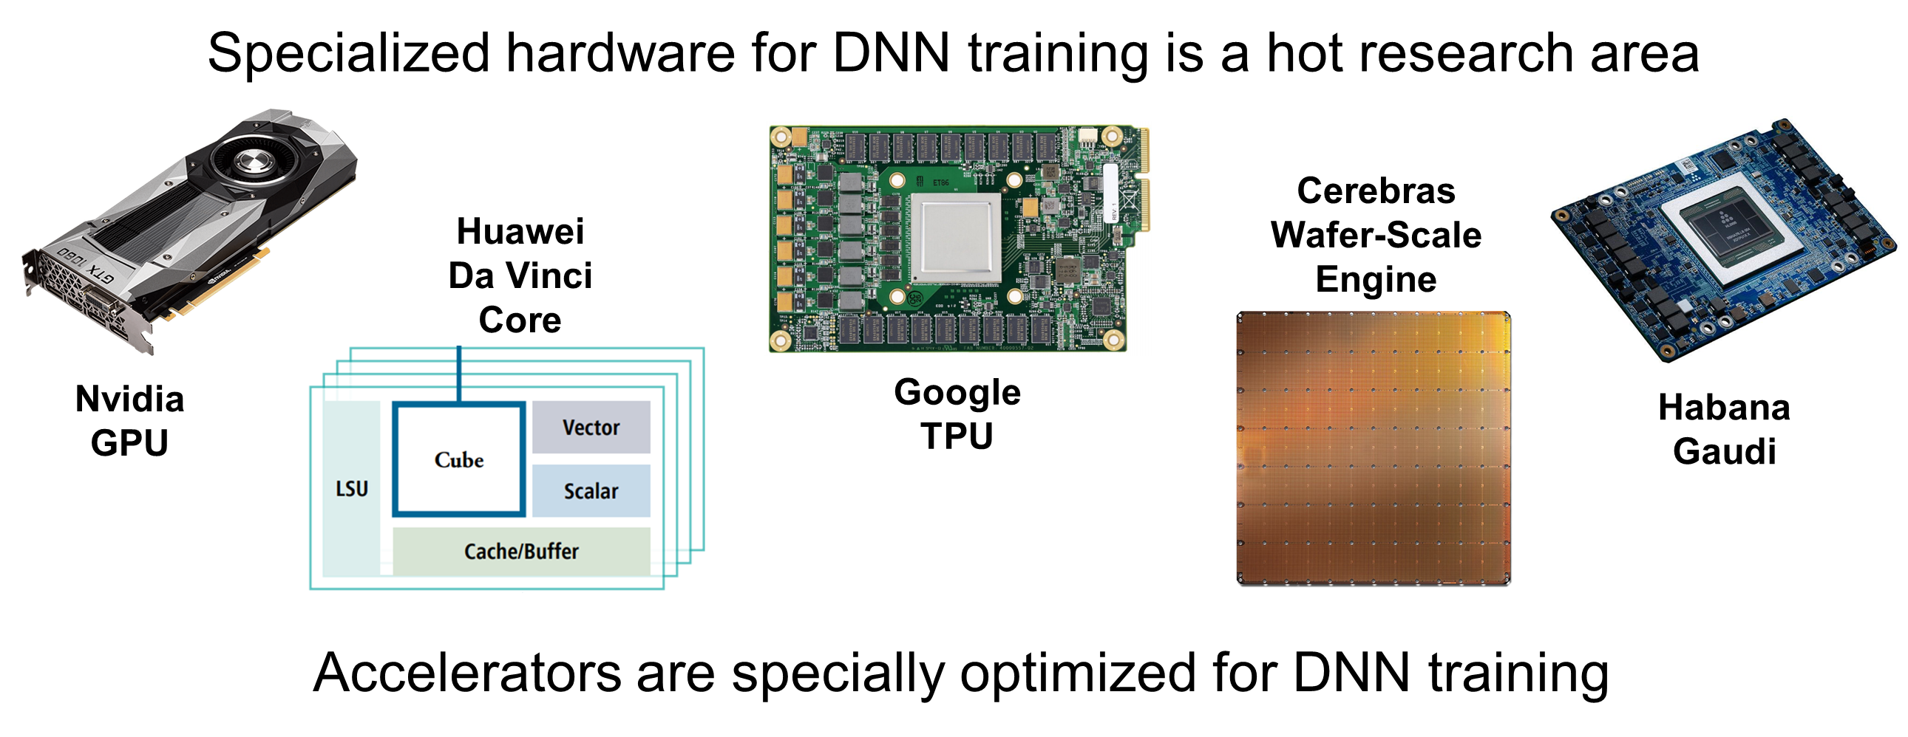
Challenges for Metrics & Profiling

Slide 32
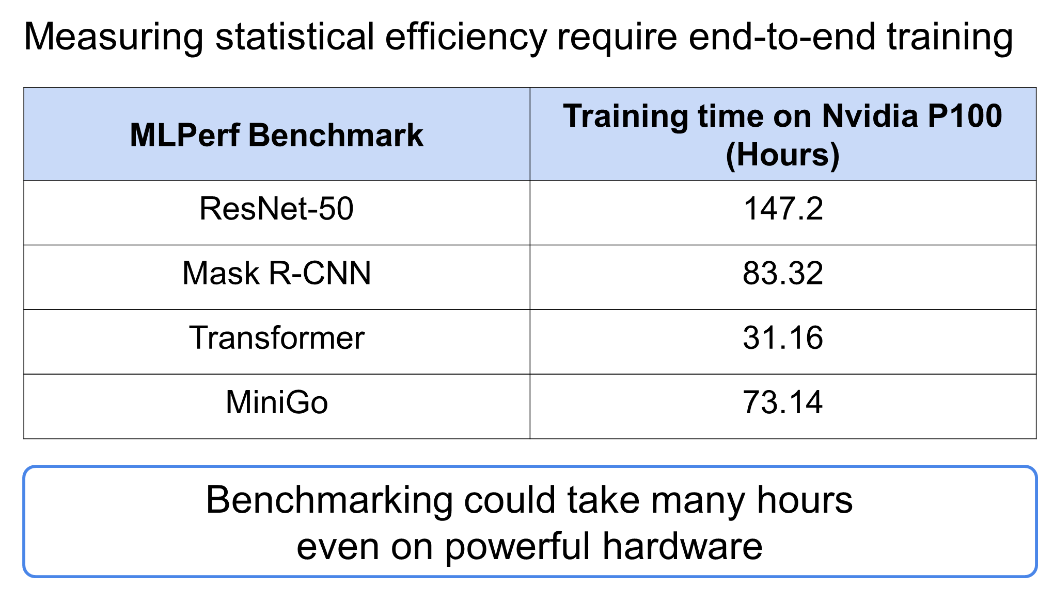
Challenges for Metrics & Profiling (2)

Slide 33
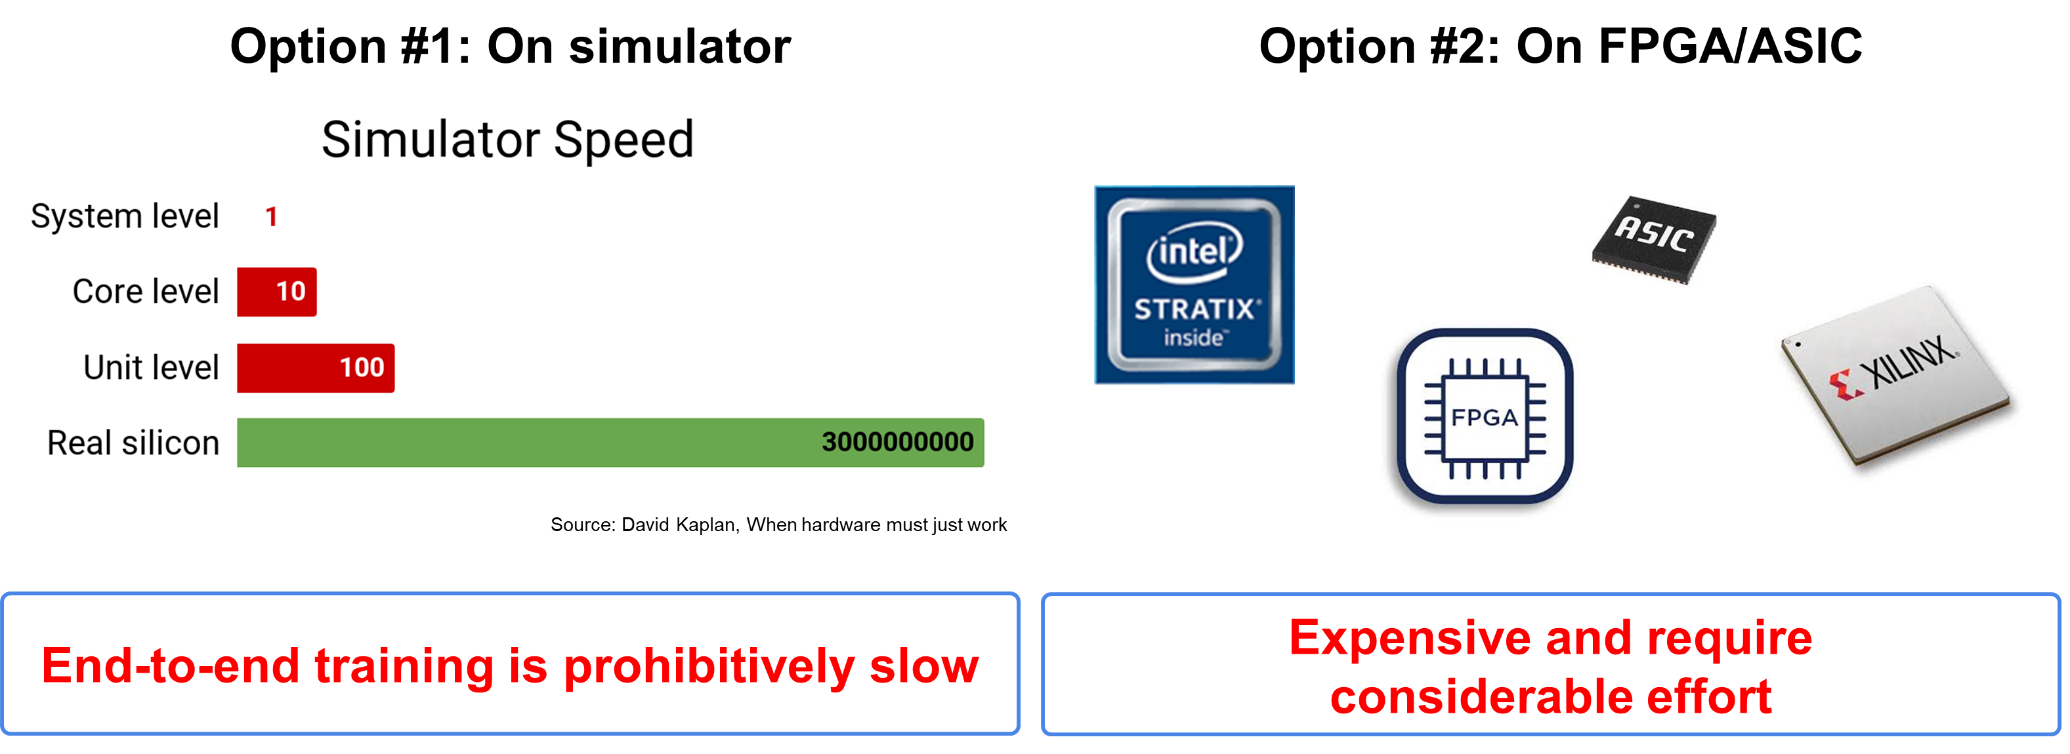
Challenges for Metrics & Profiling (3)

Slide 34
Performance bottlenecks in DNN Training
Diverse benchmark suite with state-of-the-art models
Analysis & Optimizations
Tools
Key performance metrics

Slide 35
DNN Training and Inference :
Trends and State-of-the-Art

Slide 36
DNN Training and Inference :
Trends and State-of-the-Art
1. Memory is still an Issue

Slide 37
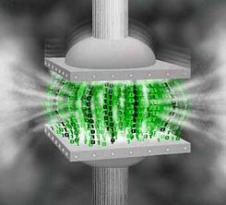
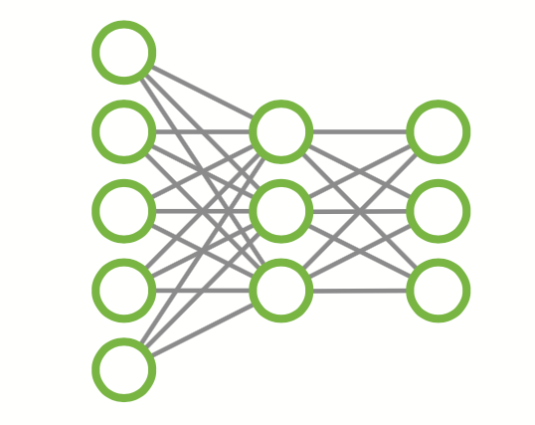

Gist: Efficient Data Encoding for
Deep Neural Network Training

Slide 38
Our Insight
Lx
Ly
Forward pass
Backward pass
Lz
Timeline
Feature map
Large temporal gap between 2 uses
Generated
1st use
2nd use
Baseline
Feature map stored in FP32 format
Our approach
Encode()
Smaller format between 2 uses
Decode()

Slide 39
Layer-Specific Encodings
Key Idea:
  Use layer-specific compression
Can be both fast and efficient
Can be even lossless
  Usually difficult for FP32

Slide 40
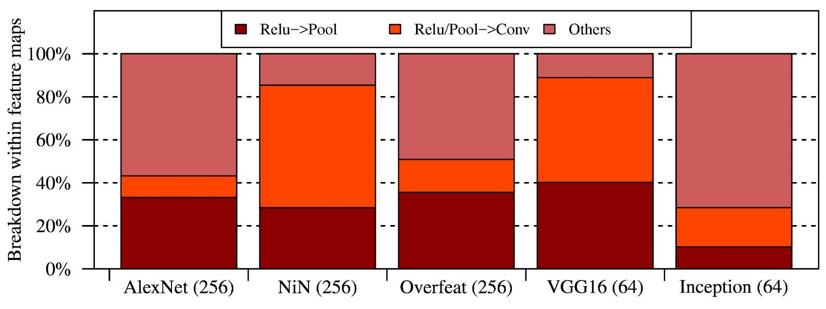
Relu Importance
Significant footprint is due to Relu layer
CNTK Profiling

Slide 41
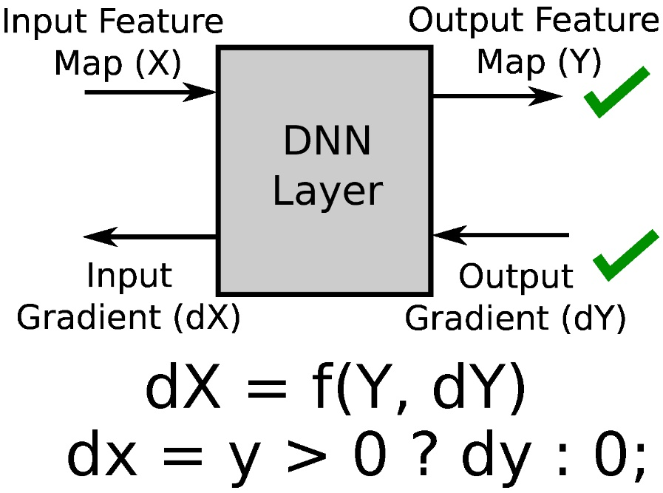
Relu -> Pool
Relu Backward Propagation
Binarize – 1 bit representation
(Lossless)

Slide 42
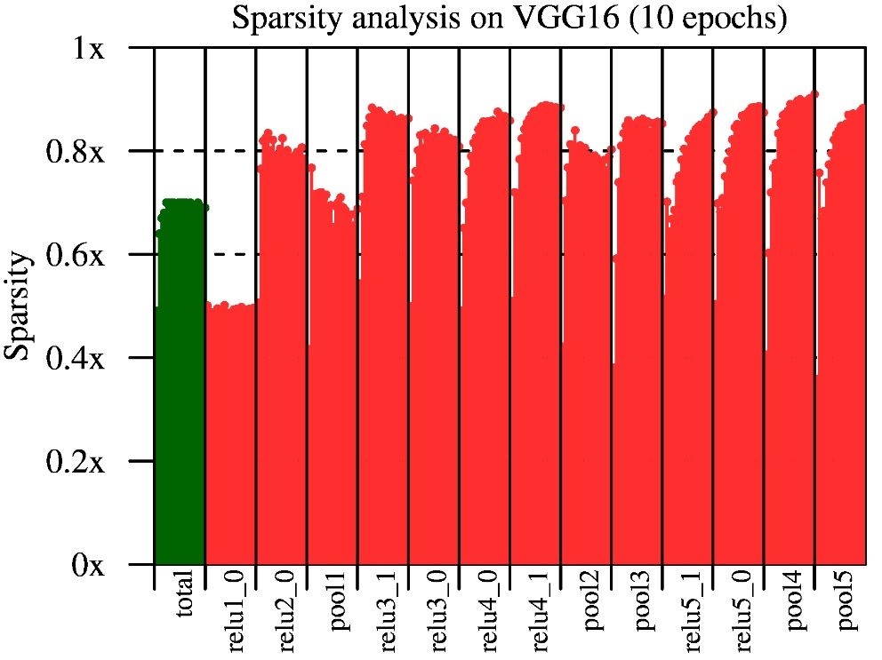
Relu/Pool -> Conv
Sparse Storage Dense Compute
(Lossless)

Slide 43


Opportunity for Lossy Encoding
Precision Reduction
Error
AlexNet : 16-bit
doesn’t train
L1
L2
L3
L4
Forward
pass
Precision reduction in forward pass quickly degrades accuracy
2nd uses
Backward
pass
L1
L2
L3
L4
Restricting precision reduction to the 2nd use results in aggressive bit savings with no effect on accuracy

Slide 44
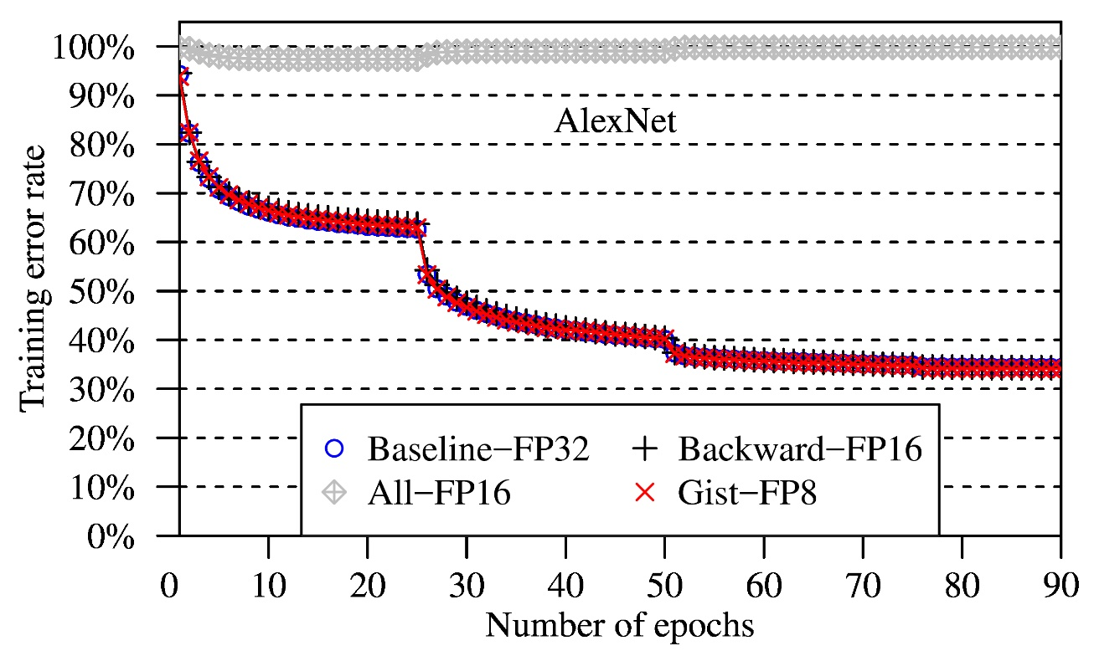
Delayed Precision Reduction
Training with Reduced Precision
Delayed Precision Reduction
(Lossy)

Slide 45
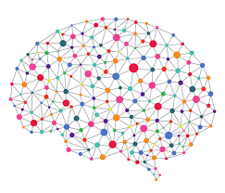
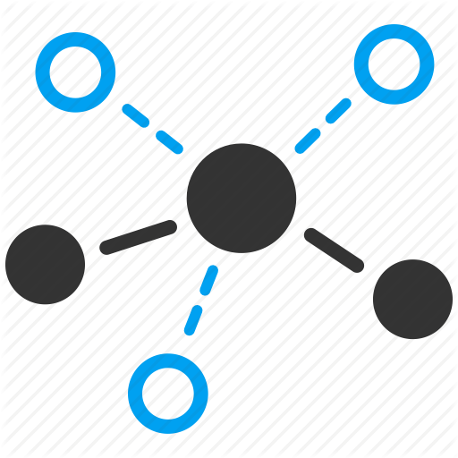

Proposed System Architecture - Gist
DNN
Identifies encoding opportunity
Modified execution graph
Gist
Execution graph
Efficient memory
sharing
Memory allocation for new data structures

Slide 46
Compression Ratio
Up to 2X compression ratio
With minimal performance overhead

Slide 47
Gist Summary
Systematic memory breakdown analysis for image classification
Layer-specific lossless encodings
  Binarization and sparse storage/dense compute
Aggressive lossy encodings
  With delayed precision reduction
Footprint reduction measured on real systems:
  Up to 2X reduction with only 4% performance overhead
  Further optimizations – more than 4X reduction

Slide 48
Echo: Compiler-based GPU Memory Footprint Reduction for LSTM RNN Training
Bojian Zheng et al.
ISCA 2020

Slide 49
CHECKMATE: BREAKING THE MEMORY WALL
WITH OPTIMAL TENSOR REMATERIALIZATION
Paras Jain et al. (UC Berkeley)
MLSys 2020

Slide 50
There are many more
NeurIPS 2019
Another paper at ISCA 2020 (jpeg encoding for CNNs)
…

Slide 51
DNN Training and Inference :
Trends and State-of-the-Art
2. Distributed Training:
Algorithms and Networking

Slide 52

Priority-based Parameter Propagation (P3) for Distributed DNN Training
Anand Jayarajan et al.

Slide 53
P3 Followups
TicTac from UIUC
BytePS (SOSP’19) from ByteDance

Slide 54
PLink: Discovering and Exploiting Locality for Accelerated Distributed Training on the Public Cloud-based Distributed Systems
UW and Microsoft Research
MLSys 2020

Slide 55
Blink: Fast and Generic Collectives for Distributed ML
UC Berkeley, U of Wisconsin, and Microsoft Research
MLSys 2020

Slide 60

Scaling Back-Propagation by
Parallel Scan Algorithm
Shang Wang^{1,2}, Yifan Bai¹, Gennady Pekhimenko^{1,2}
¹
²

Slide 61
Executive Summary
The back-propagation (BP) algorithm is popularly used in training deep learning (DL) models and implemented in many DL frameworks (e.g., PyTorch and TensorFlow).
Problem: BP imposes a strong sequential dependency along layers during the gradient computations.
Key idea: We propose scaling BP by Parallel Scan Algorithm (BPPSA):
Reformulate BP into a scan operation.
Scaled by a customized parallel algorithm.
1
2
3
4
5
6
7
8
Key Results: Θ(log n) vs. Θ(n) steps on parallel systems.
Up to 108× backward pass speedup (→ 2.17× overall speedup).
0
1
3
6
10
15
21
28

Slide 62
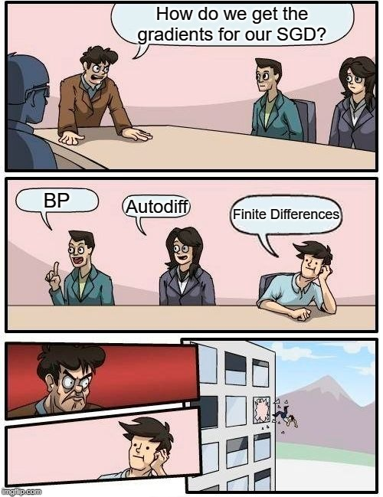






Back-propagation¹ (BP) Everywhere
¹Rumelhart et al. “Learning representations by back-propagating errors.”, Nature (1986)

Slide 63

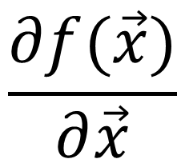




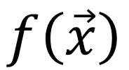
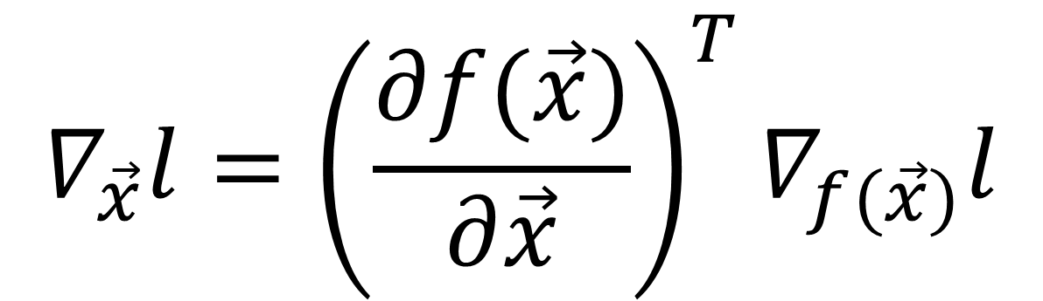
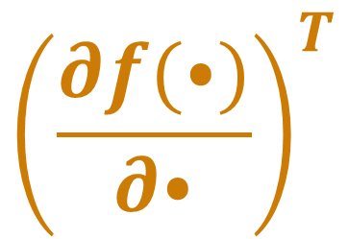


BP’s Strong Sequential Dependency
$$\vec{x}$$
Linear
ReLU
Linear
Loss
$$\vec{x}$$
$$l$$
$$∇ l$$
$${\left(\frac{∂f(⦁)}{∂⦁}\right)}^{T}$$
$$∇l$$
$${\left(\frac{∂f(⦁)}{∂⦁}\right)}^{T}$$
$$∇l$$
$$\frac{∂f(\vec{x})}{∂\vec{x}}$$
$$f\left(\vec{x}\right)$$
Jacobian
$$∇_{\vec{x}}l={\left(\frac{∂f(\vec{x})}{∂\vec{x}}\right)}^{T}∇_{f(\vec{x})}l$$
Strong Sequential Dependency along layers.

Slide 64
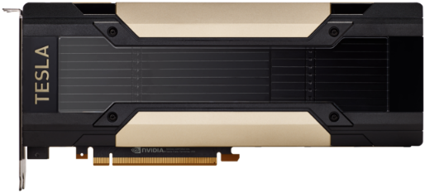



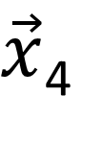
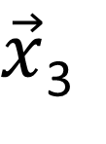

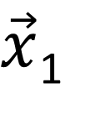


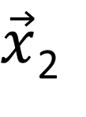

Data Parallel Training
Strong Sequential Dependency
$\vec{x}$₁
$l$₁
Respects BP’s strong sequential dependency.
Strong Sequential Dependency
$\vec{x}$₂
$l$₂
Conceptually simple, widely used.
Strong Sequential Dependency
$\vec{x}$₃
$l$₃
Effectively increases the batch size:
Generalization gap¹
Batch size scaling limit²
$\vec{x}$₄
$l$₄
Constraint: The model must fit in one device.
$\vec{x}$_{i}
$l$_{i}
¹Keskar, Nitish Shirish et al. “On Large-Batch Training for Deep Learning: Generalization Gap and Sharp Minima.” ICLR (2017)
²Shallue, Christopher J. et al. “Measuring the Effects of Data Parallelism on Neural Network Training.” Journal of Machine Learning Research 20 (2019)

Slide 65

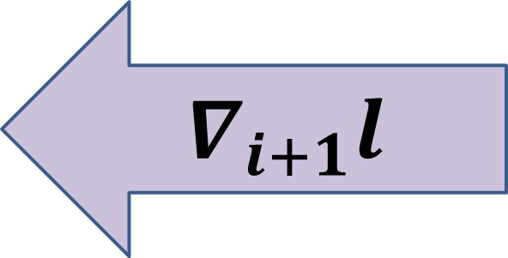
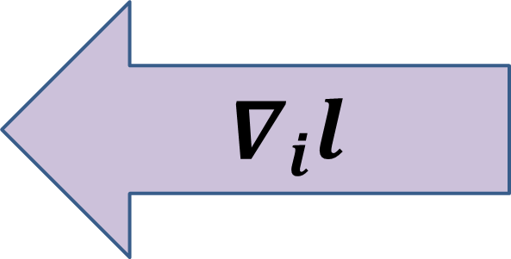
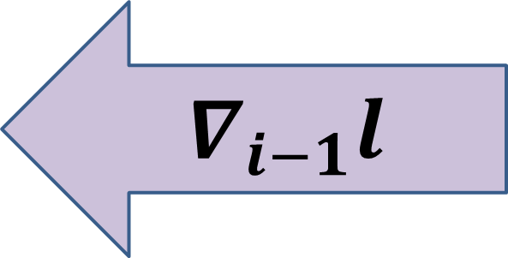
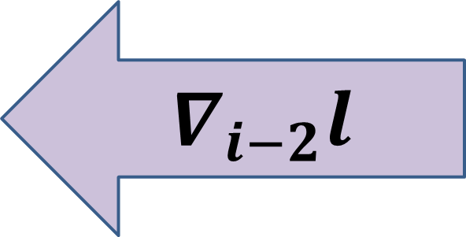
Model Parallel Training
Used when the model cannot fit in one device.
BP’s strong sequential dependency limits scalability.
Prior works on pipeline parallel training^{1,2} to mitigate such problem, but have their own limitations:
Linear per-device space complexity.
Trade-off between “bubble of idleness” vs. potential convergence affect.
$$∇_{i−2}l$$
Conv
$$∇_{i−1}l$$
Conv
$$∇_{i}l$$
Linear
$$∇_{i+1}l$$
¹Harlap, Aaron et al. “PipeDream: Fast and Efficient Pipeline Parallel DNN Training.” SOSP (2019)
²Huang, Yanping et al. “GPipe: Efficient Training of Giant Neural Networks using Pipeline Parallelism.” NeurIPS (2019)

Slide 66


Rethinking BP from an Algorithm Perspective
Prior Works
Problems with strong sequential dependency were studied in the past (80’), but in a much simpler context.
BP
We propose scaling Back-Propagation by Parallel Scan Algorithm (BPPSA):
  Reformulate BP as a scan operation.
  Scale BP by a customized Blelloch Scan algorithm.
  Leverage sparsity in the Jacobians.
BP
BPPSA

Slide 67
What is a Scan¹ Operation?
Binary, associative operator: +
Identity: 0
Input sequence:
1
2
3
4
5
6
7
8
Exclusive scan:
0
1
3
6
10
15
21
28
Compute partial reductions at each step of the sequence.
¹Blelloch, Guy E. ”Prefix sums and their applications”. Technical Report (1990)

Slide 68
Linear Scan
1
2
3
4
5
6
7
Step: executing the operator once.
3
Number of Elements (n)
6
Worker (p): an instance of execution; e.g., a core in a multi-core CPU
10
n
Time
On a single worker: perform scan linearly; takes n steps.
15
With more workers: Can we achieve sublinear steps?
21
28

Slide 69
Blelloch Scan: ① Up-sweep Phase
1
2
3
4
5
6
7
8
3
7
11
15
Up-sweep
A
B
10
26
A+B
Time
Compute partial sums via a reduction tree.

Slide 70
Blelloch Scan: ② Down-sweep Phase
1
2
3
4
5
6
7
8
Parallel
3
7
11
15
Down-sweep
A
B
10
26
B
A+B
10
0
Time
3
0
11
10
Combine partial sums across branches.
1
0
3
3
5
10
7
21
0
1
3
6
10
15
21
28

Slide 71
Blelloch Scan: Efficiency
1
2
3
4
5
6
7
8
3
7
11
15
10
26
Logarithmic steps along the critical path.
2logn
10
0
Time
3
0
11
10
1
0
3
3
5
10
7
21
0
1
3
6
10
15
21
28

Slide 72
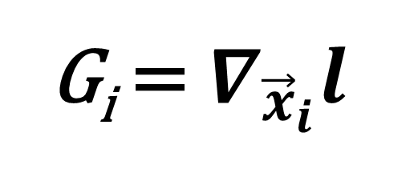
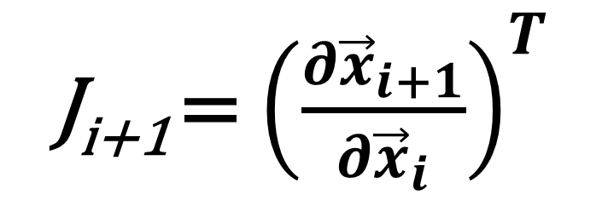
Reformulate BP as a Scan Operation
G_{i} = $∇_{{\vec{x}}_{i}}l$
J_{i+1} = ${\left(\frac{∂{\vec{x}}_{i+1}}{∂{\vec{x}}_{i}}\right)}^{T}$
Binary, associative operator:
+
A ◊ B = BA
Identity:
I
0
Input sequence:
G₇
1
J₇
2
J₆
3
J₅
4
J₄
5
J₃
6
J₂
7
J₁
8
Exclusive scan:
0
1
3
6
10
15
21
28
I
G₇
G₆
G₅
G₄
G₃
G₂
G₁
Key Insight: matrix multiplication in BP is also binary & associative!

Slide 73
Scale BP by Blelloch Scan
G₇
1
J₇
2
J₆
3
J₅
4
J₄
5
J₃
6
J₂
7
J₁
8
G₆
3
J_{5:6}
7
J_{3:4}
11
J_{1:2}
15
G₄
10
J_{1:4}
26
Logarithmic steps along the critical path!
2logn
G₄
10
I
0
Time
G₆
3
I
0
J_{3:4}
11
G₄
10
Down-sweep
A
B
G₇
1
I
0
J₆
3
G₆
3
J₄
5
G₄
10
J₂
7
G₂
Matrix multiplications are noncommutative.
21
B
AB
BA
I
0
G₇
1
G₆
3
G₅
6
G₄
10
G₃
15
G₂
21
G₁
28

Slide 74
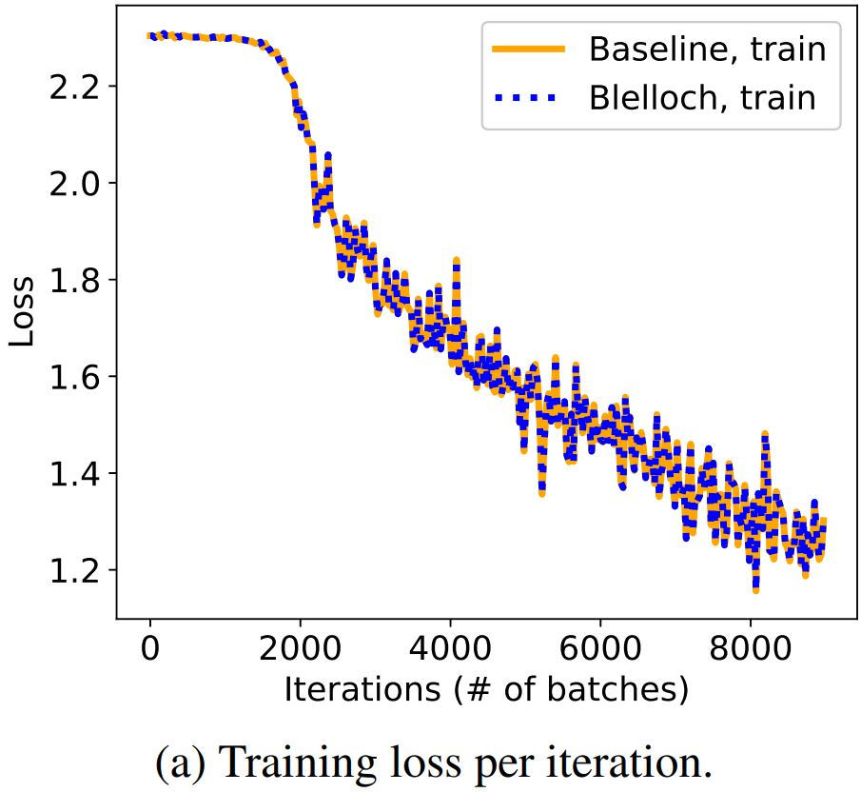
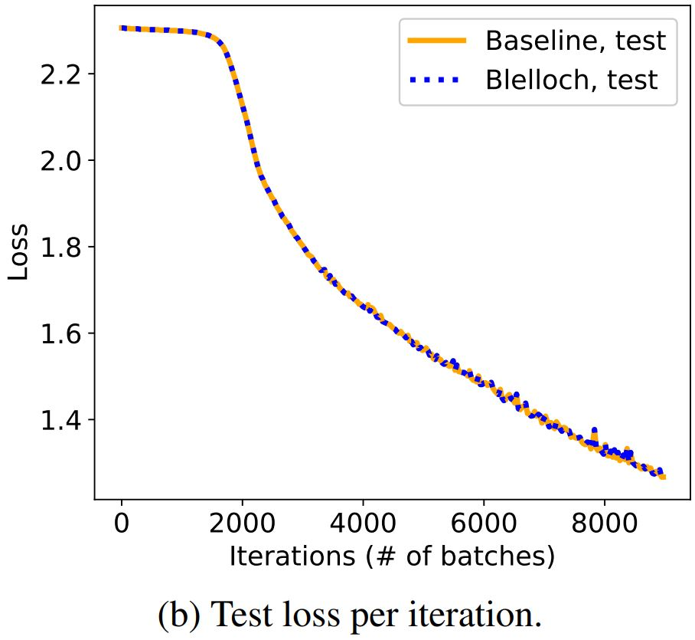
Reconstructs the Original BP Exactly
Our method produces gradients mathematically equivalent to BP.
The Jacobians are multiplied in a different order → numerical differences.
Empirically show that such differences do not effect convergence.
Training LeNet-5 on CIFAR-10 (baseline: PyTorch Autograd)

Slide 75











Jacobians are Memory & Compute Hungry
A full Jacobian can be prohibitively expensive to handle.
e.g., 1st convolution in VGG-11 on CIFAR-10 images occupy 768 MB of memory.
Generated one row at a time by passing basis vectors into Op_Grad() (the VJP function).
Conventional ML algorithms avoid using Jacobians directly (including BP).
$$Conv2d_Grad(\left[\begin{matrix}1 \\ 0 \\ 0 \\ \begin{aligned}0 \\ 0 \\ 0 \\ 0\end{aligned}\end{matrix}\right])$$
$$\vec{x}$$
ML Algo.
$$Conv2d_Grad(\left[\begin{matrix}0 \\ 0 \\ 1 \\ \begin{aligned}0 \\ 0 \\ 0 \\ 0\end{aligned}\end{matrix}\right])$$
3072
$$Conv2d_Grad(\left[\begin{matrix}0 \\ 1 \\ 0 \\ \begin{aligned}0 \\ 0 \\ 0 \\ 0\end{aligned}\end{matrix}\right])$$
$$Conv2d_Grad(\left[\begin{matrix}0 \\ 0 \\ 0 \\ \begin{aligned}0 \\ 1 \\ 0 \\ 0\end{aligned}\end{matrix}\right])$$
$$Conv2d_Grad(\left[\begin{matrix}0 \\ 0 \\ 0 \\ \begin{aligned}1 \\ 0 \\ 0 \\ 0\end{aligned}\end{matrix}\right])$$
$$Conv2d_Grad(\left[\begin{matrix}0 \\ 0 \\ 0 \\ \begin{aligned}0 \\ 0 \\ 0 \\ 1\end{aligned}\end{matrix}\right])$$
$$Conv2d_Grad(\left[\begin{matrix}0 \\ 0 \\ 0 \\ \begin{aligned}0 \\ 0 \\ 1 \\ 0\end{aligned}\end{matrix}\right])$$
65536
768 MB
$$\frac{∂f(\vec{x})}{∂\vec{x}}$$
$$f\left(\vec{x}\right)$$
Jacobians

Slide 76



The Jacobians of Many Operators are Sparse
Non-zeros
Possible Zeros
Guaranteed Zeros
Guaranteed zeros:
Known ahead of training time.
Deterministic pattern.
Potentially better SpGEMM performance.
Conv2d
ReLU
MaxPool2D
First three ops of VGG-11 on CIFAR-10 | Convolution | ReLU | Max Pooling
Sparsity | 0.99157 | 0.99998 | 0.99994

Slide 77
Fast Sparse Jacobians Generation
Therefore, instead of calculating the Jacobians row-wise,
generate directly into Compressed Sparse Row (CSR):
data
0
0
0
0
0
0
Conv2d, W
1
2
0
3
indices
0
0
0
0
0
0
0
1
2
2
4
indptr
First three ops of VGG-11 on CIFAR-10 | Convolution | ReLU | Max Pooling
Jacobian Calculation Speedup | 8.3×10³ x | 1.2×10⁶ x | 1.5×10⁵ x

Slide 78
Complexity Analysis
Runtime:
Per-step Complexity (C): runtime of each step.
BPPSA
BP
C_{BPPSA}
Θ(log n)
vs.
C_{BP} Θ(n)
Performance benefits:
Large n: deep network, long sequential dependency.
Reducing per-step complexity: SpGEMM.
In-place
Up-sweep
Down-sweep
A
B
A
B
Constant per-device space complexity!
BA
B
AB

Slide 79
Methodology: Benchmark
Model: RNN
Task: Bitstream Classification
$${\vec{h}}_{t}^{\left(k\right)}=\tanh\left(W_{ih}x_{t}^{\left(k\right)}+{\vec{b}}_{ih}+W_{hh}{\vec{h}}_{t−1}^{\left(k\right)}+{\vec{b}}_{hh}\right)$$
C=4
V100
0
1
0
0
1
0
0
1
1
0
$$x_{t}^{\left(k\right)}{\sim Bernoulli(0.05+C}^{\left(k\right)}×0.1)$$

Slide 80

Methodology: Environment
Hardware:
RTX 2070
RTX 2080 Ti
Baseline:
7.5.1
7.6.2
1.1
1.2
Implementation: custom CUDA 10 kernels.

Slide 81
End-to-end Training Speedup
Training curve of BPPSA v.s. the baseline
when batch size B=16, sequence length T=1000:
Numerical differences do not effect convergence.
2.17× speedup on the overall training time.

Slide 82
Sensitivity Analysis: Model Length
Sequence length (T) reflects the model length n.
108× =
BPPSA scales with the model length (n);
until being bounded by the number of workers (p).

Slide 83

Sensitivity Analysis: Number of Workers
Fraction of GPU per sample (1/B) reflects the number of workers p.
BPPSA scales with the number of workers (p).

Slide 84
Sensitivity Analysis: 2070 v.s. 2080Ti
#SMs(2070) < #SMs(2080Ti)
→ Latency(2070) > Latency(2080Ti)
SM: Streaming Multiprocessor; i.e., “Parallel Cores”.

Slide 85
More Results in the Paper
End-to-end benchmarks of GRU training on IRMAS.
  A more realistic version of the RNN results.
Pruned VGG-11 retraining on CIFAR-10.
  Microbenchmark via FLOP measurements.
  Evaluate the effectiveness of leveraging the Jacobians’ sparsity in CNNs.

Slide 86
Conclusion
BP imposes a strong sequential dependency among layers during the gradient computations, limiting its scalability on parallel systems.
We propose scaling Back-Propagation by Parallel Scan Algorithm (BPPSA):
Reformulate BP as a scan operation.
Scale by a customized Blelloch scan algorithm.
Leverage sparsity in the Jacobians.
Key Results: Θ(log n) vs. Θ(n) steps on parallel systems.
Up to 108× speedup on the backward pass (→ 2.17× overall speedup).

Slide 87
DNN Training and Inference :
Trends and State-of-the-Art
3. Inference:
More Solid Quantization and Pruning

Slide 88
What is the State of Neural Network Pruning?
MIT
MLSys 2020

Slide 98
Memory-Driven Mixed Low Precision Quantization for Enabling Deep Network Inference on Microcontrollers
Universita’ di Bologna, Bologna, Italy
MLSys 2020

Slide 99
DNN Training and Inference :
Trends and State-of-the-Art
4. ML Compilers

Slide 100
Existing Efforts : Pros and cons
TVM, XLA, Glow, PlaidML
  Don’t perform well for training
  TVM can be 2-3 orders of magnitude worse on important kernels
We need a new ML compiler with representative IR
  Any thoughts? Why not ML IR?
We want LLVM-like style optimizers
  E.g., we can try all three major approaches to footprint reduction together

Slide 101
CSC 2224: Parallel Computer
Architecture and Programming
DNN Training and Inference :
Challenges, Trends, State-of-the-Art
Prof. Gennady Pekhimenko
University of Toronto
Fall 2020
The content of this lecture is adapted from the slides of Kayvon Fatahalian (Stanford), Olivier Giroux and Luke Durant (Nvidia), Tor Aamodt (UBC) and Edited by: Serina Tan

